Slide 1

The New Testament Literary Context
Primary Sources to Understand the
First Century
Dr. Rick Griffith • Jordan Evangelical Theological Seminary • BibleStudyDownloads.org

Slide 2
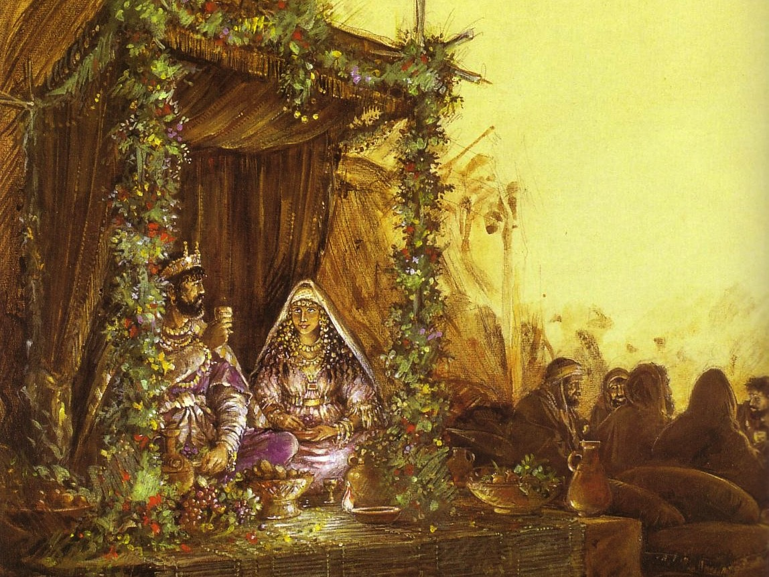
Marriage Backgrounds in Jewish Literature
Marriage depicts Christ's love for the church (Eph. 5)
The order of marriage customs parallels church eschatology

Slide 3
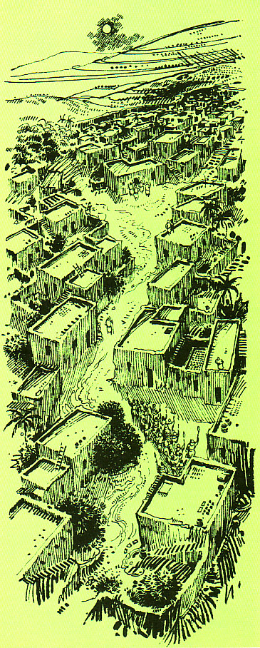
The First Century Wedding Procession
Groom's House
The procession parallels Christ's return for His Bride, the Church
Bride's House

Slide 4

"We will rise to meet Him"
(1 Thess. 4:16)

Slide 5
Marriage & the Church Timeline
Marriage & the Church Timeline
Election God the Father chose those to be saved (Eph. 1:5, 11) | Purchase Christ paid the Father His blood to redeem the church (1 Pet. 1:18) | Sign New covenant began with the cup of the Supper (Luke 22:20) | Our Job Holiness for Christ during church age (2 Cor. 11:2) | Christ's Job Preparing heaven for church until He returns (John 14:1-3) | Rapture Christ brings church to heaven at unexpected time w/ shout (1 Thess. 4:14-18) | Wedding Church cleansed & presented unspotted (rewarded) in heaven (Eph. 5:26) | Supper to Come Church unites with Christ & glorifies Him for imparting holiness (Rev. 19:7-9) | Second Coming & Supper Saints & Christ return to earth to reign (Rev. 19:11-20:6)
Church Age
Tribulation
Millennium
(Church & Christ) Separated
Betrothal Period
(Bride & Groom Separated)
Choice (Shiddukhin) Father chooses a bride for his son (Tobit 4.12-13; 7.9-13; Ecclesiast. 7.23; Sirach 7.25; Mishna Kiddushin 2.1) | Purchase (Mohar) Groom pays bride's father gold & silver or service as dowry (Tobit 8.21; Jub. 28.2) | Sign (Ketubah) Marriage covenant begins with contract & cup of betrothal (Tobit 7.14-15; Kidd. 2.2; Ketuboth 1.2) | Bride's Job (Kedeshet) Maintains virginity (set apart for groom) one year (Mishna Sotah 1.1, 5; 5.1; Sirach 42.10) | Groom's Job (Huppah) Prepares bridal chamber and place in home of his father (1 Macc. 3.56; 2 Enoch 61.2) | Procession (Nissuim) Groom's surprise arrival, calls bride & escorts her to his father's house (Adam & Eve 22.3; 4 Ezra 6.23) | Wedding (Sheva Brachot = 7 Nuptial blessings) bride washes, adorns, presented by groom as beautiful virgin (Tobit 7.13) & declared married | Wedding Supper Intercourse (Mishna Ketuboth 1.1; 3 Macc. 1.19; 4.6) began a 7-14 day feast (Tobit 8.19-20; 9.6); guests given white linen & groom praised for beauty given to the bride | Married Life Bride & groom live in society to serve God together (Gen. 2:24; Matt. 19:4-6)
10th ed. 14 Apr 2011

Slide 6
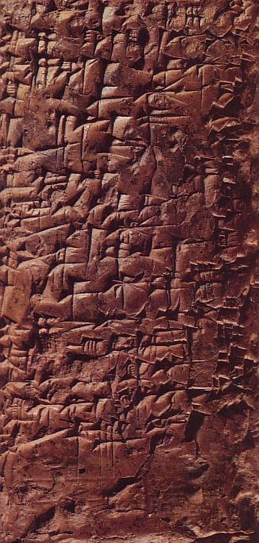
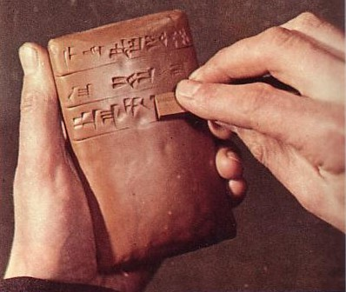
Cuneiform Writing
Preceded Hebrew by hundreds of years

Slide 7
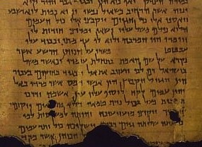
Overview of Literature Section
154-198
Inspired Writings (Canonical)
  OT
  NT
Uninspired Writings (Backgrounds)
  Greek
  Roman
  Jewish
  Christian
  Gnostic

Slide 8

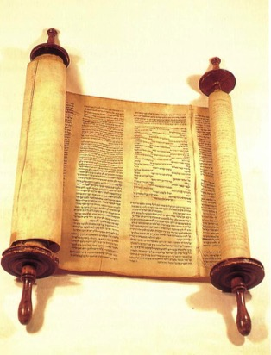
Chronological Literature Chart
Dates show time of writing and works appear in italics
400 300 200 100 BC/AD 100 200 300 400 500 600 700
GREEK LXX
(Greek OT)
Polybius
Diodorus
Strabo
Plutarch
----- Hermetica ----
Philo
JEWISH ^{(Jewish/Greek)}
OT Jamnia "Council" MT
(completed) 600-1000
------OT Apocrypha-----
---------- Pseudepigrapha -------(some extended to 7th century)
- Dead Sea Scrolls -
---------------- Rabbinic Literature --------------
------------- Midrash (oral tradition) ----------
Talmud = Mishnah 200 + Gemara 500
--- Tosefta ---
Josephus 77-94
ROMAN (Jew writing for Rome)
Cicero
Livy
Pliny 113
Tacitus 115
CHRISTIAN
New Testament 40s-95
Apostolic Fathers 95-150
Most notable:
• Didache 95-120
• Epistle of Barnabas 70-132
----------------- NT Apocrypha ----------------
• Nag Hammadi Codices (Gnostic)
• Gospel of Thomas
MISCELLANEOUS
------------------------------- Select Papyri --------------------------------------------
158

Slide 9


I. Inspired Writings
154-157
A. Old Testament
1. Hebrew: Masoretic Text (MT)
2. Greek: Septuagint (LXX)
3. OT Canonicity
B. New Testament
1. Dates
2. NT Canonicity

Slide 10

Jewish Writings
The Book of Psalms

Slide 11
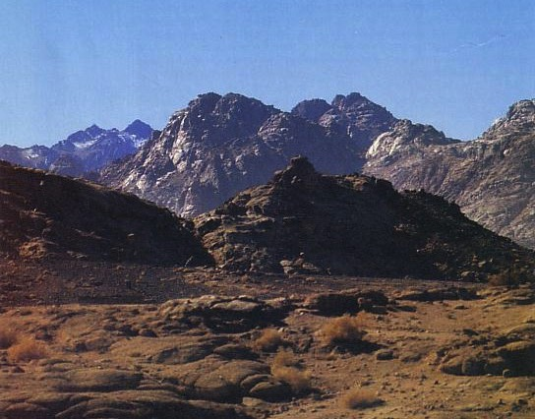
We have no Hebrew writings today that existed before Mt. Sinai (1445 BC)

Slide 12
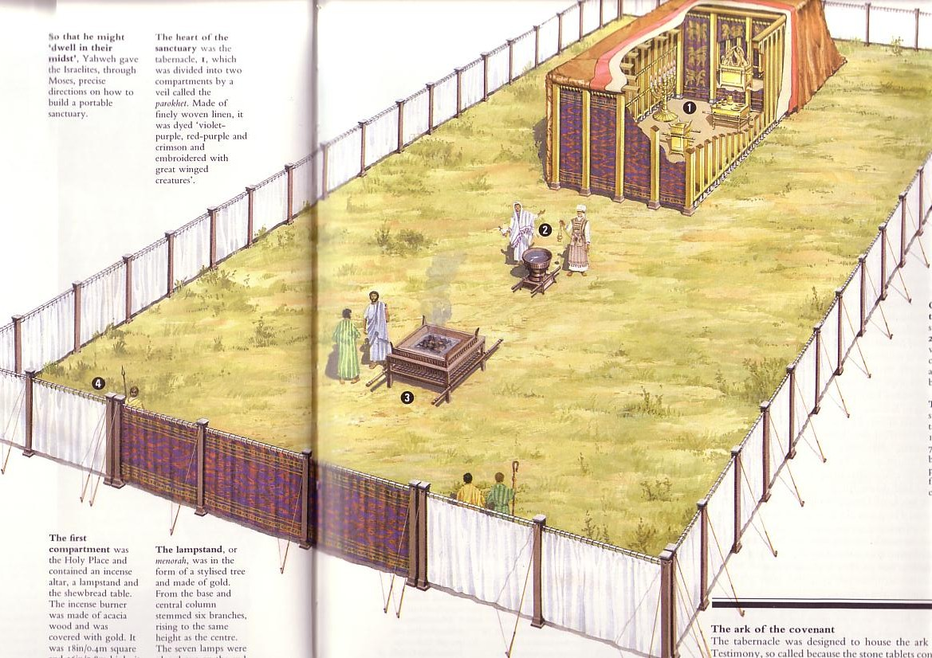
Jewish Primary Sources
Began at the Tabernacle

Slide 13
Chronological Literature Chart
158
Dates show time of writing and works appear in italics
400 300 200 100 BC/AD 100 200 300 400 500 600 700
GREEK LXX
(Greek OT)
Polybius
Diodorus
Strabo
Plutarch
----- Hermetica ----
Philo
JEWISH ^{(Jewish/Greek)}
OT Jamnia "Council" MT
(completed) 600-1000
------OT Apocrypha-----
---------- Pseudepigrapha -------(some extended to 7th century)
- Dead Sea Scrolls -
---------------- Rabbinic Literature --------------
------------- Midrash (oral tradition) ----------
Talmud = Mishnah 200 + Gemara 500
--- Tosefta ---
Josephus 77-94
ROMAN (Jew writing for Rome)
Cicero
Livy
Pliny 113
Tacitus 115
CHRISTIAN
New Testament 40s-95
Apostolic Fathers 95-150
Most notable:
• Didache 95-120
• Epistle of Barnabas 70-132
----------------- NT Apocrypha ----------------
• Nag Hammadi Codices (Gnostic)
• Gospel of Thomas
MISCELLANEOUS
------------------------------- Select Papyri --------------------------------------------

Slide 14
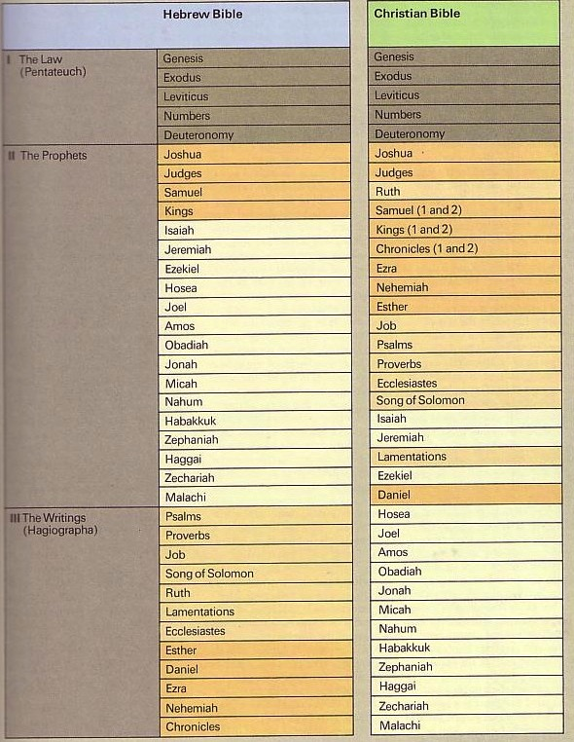
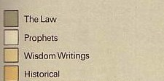
The Hebrew Canon
154
The Hebrew Canon
Jewish and Christian books are the same but in different order and classification

Slide 15
The Hebrew Canon
154
The Hebrew Canon
?
Matthew 5:17 "Do not think that I have come to abolish the Law or the Prophets;
I have not come to abolish them but to fulfill them."
Jewish and Christian books are the same but in different order and classification

Slide 16
The Hebrew Canon
154
The Hebrew Canon
Luke 24:44 "… everything written about me in the Law of Moses and the Prophets and the Psalms must be fulfilled."
Jewish and Christian books are the same but in different order and classification

Slide 17


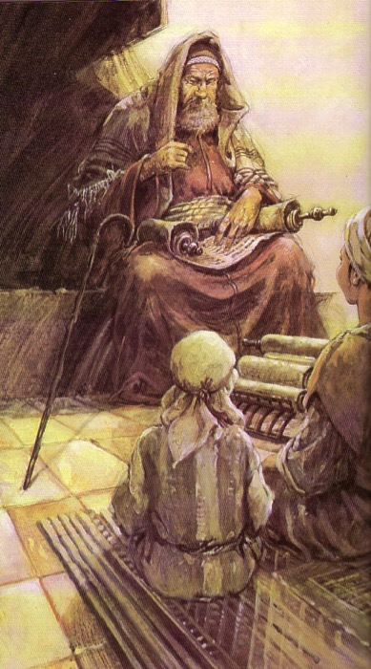
1. Hebrew: The Masoretic Text (MT)
155
Unpointed text
  (1500 BC – AD 800)
mhl rb hthsrb

Slide 18
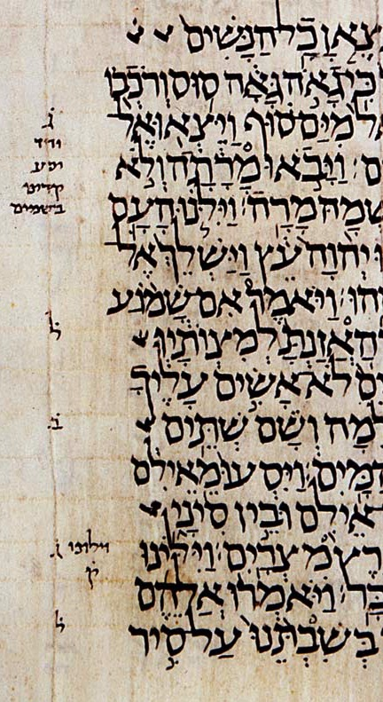
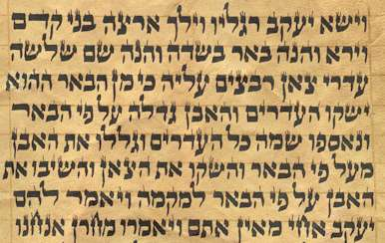
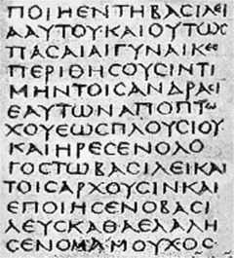
Most Hebrew manuscripts lack vowel pointing. Both Hebrew and Greek manuscripts often lack space between words too!

Slide 19
You can read without vowels too!
W rrly rd nglsh wtht vwls
bt t s pssbl wth prctc. t's vn fn!
We rarely read English without vowels
but it is possible with practice. It's even fun!

Slide 20

1. Hebrew: The Masoretic Text (MT)
155
Unpointed text
  (1400 BC – AD 800)
Pointed text by Masoretes
  (AD 800 - present)
mhl rb hthsrb
mihole arab htihsereb
Bereshith bara elohim
In the beginning God created

Slide 21
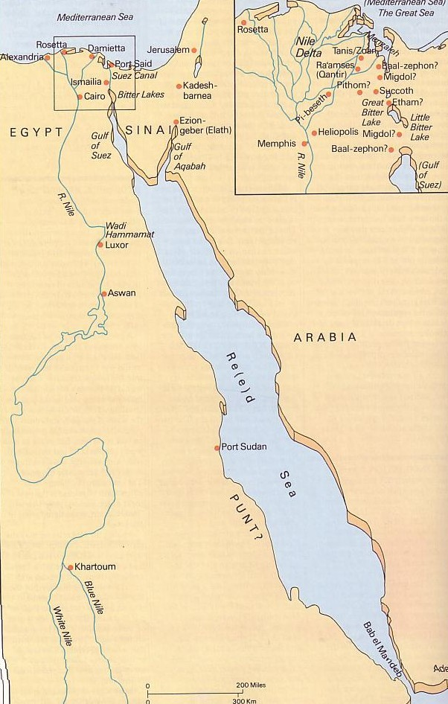
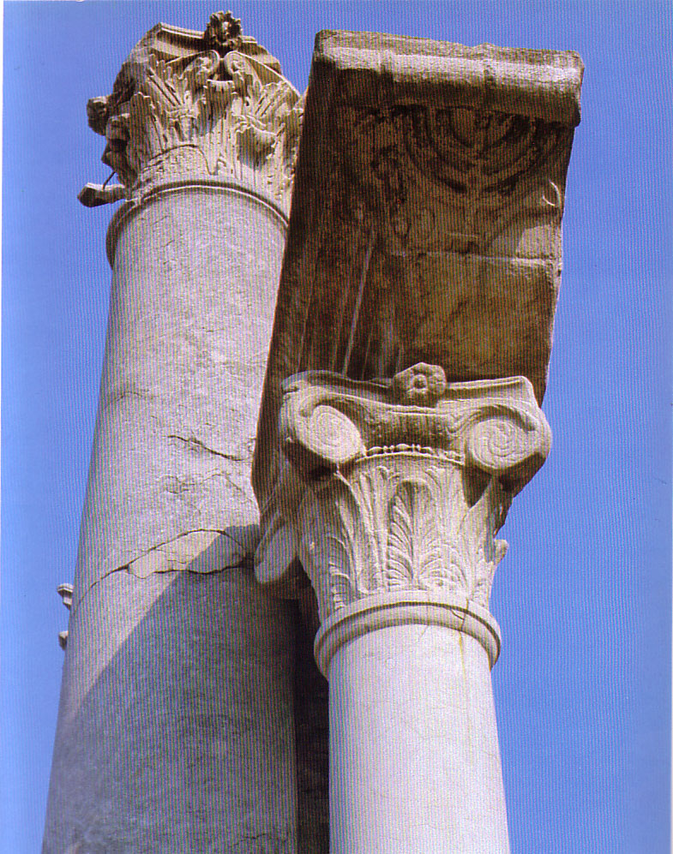

2. Greek: The Septuagint (LXX)
155
The OT Hebrew text was translated into Greek in Alexandria around 250 BC

Slide 22
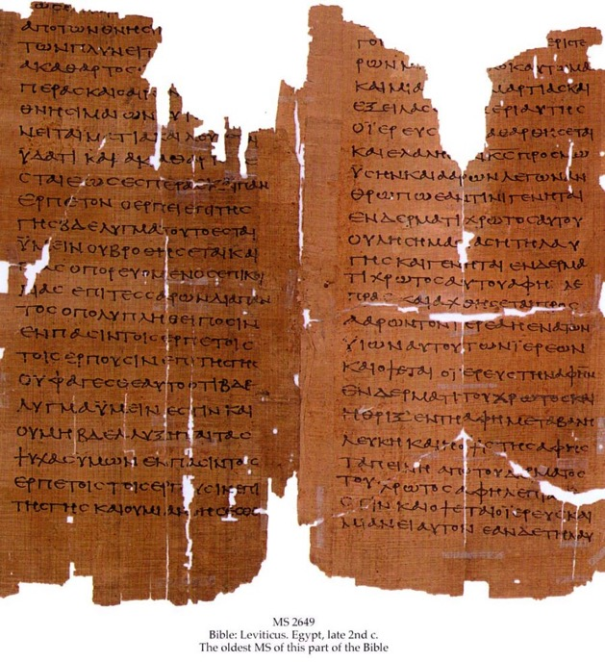
Why study the LXX?
155
Earliest translation of the Hebrew Scriptures
Valued highly by Jews
Parent text
Provides intertestamental history (has Apocrypha)

Slide 23

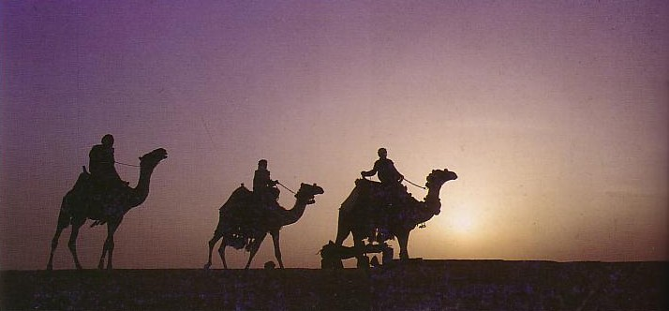
3. OT Canonicity
155-156
Accepted at Council of Jamnia, AD 90
Why Adopted So Late?
Apocrypha
LXX
Antilegomena
Samaritans
Pharisaical Tradition
What Criteria was Used?
Authoritative & Enduring
Doctrinal Suitability
Prophetic Authorship
Claim to be God's Word
Dynamic Character
Canonicity is vital for those seeking God

Slide 24
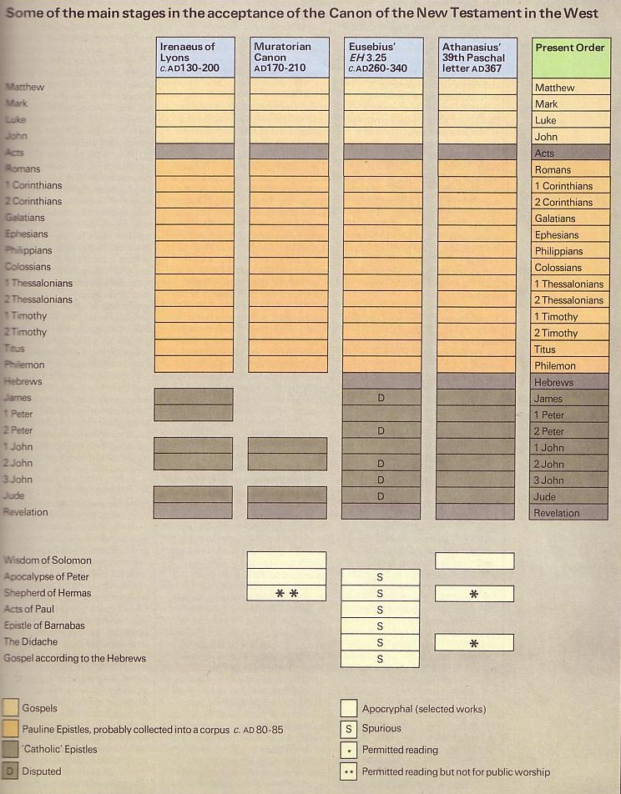
NT Canonicity
156-157
Apostolic
Accepted

Slide 25
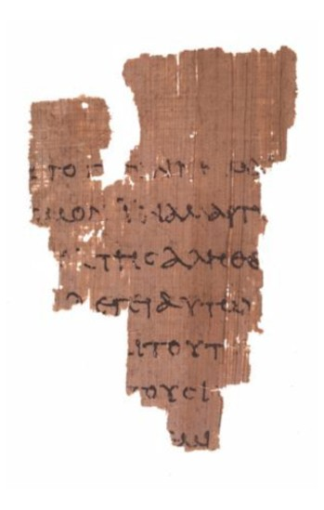
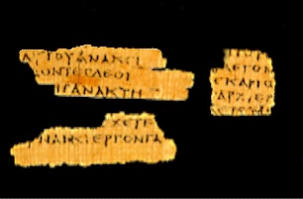
Really Early Fragments!
156-157
Magdalen Fragment of Matthew
AD 50-200
John Rylands Fragment of John 18:31-33, 37-38
AD 125
Notes:
http://www.tyndalehouse.com/staff/Head/P64TB.htm says the Magdalene fragment is actually from about AD 200.

Slide 26
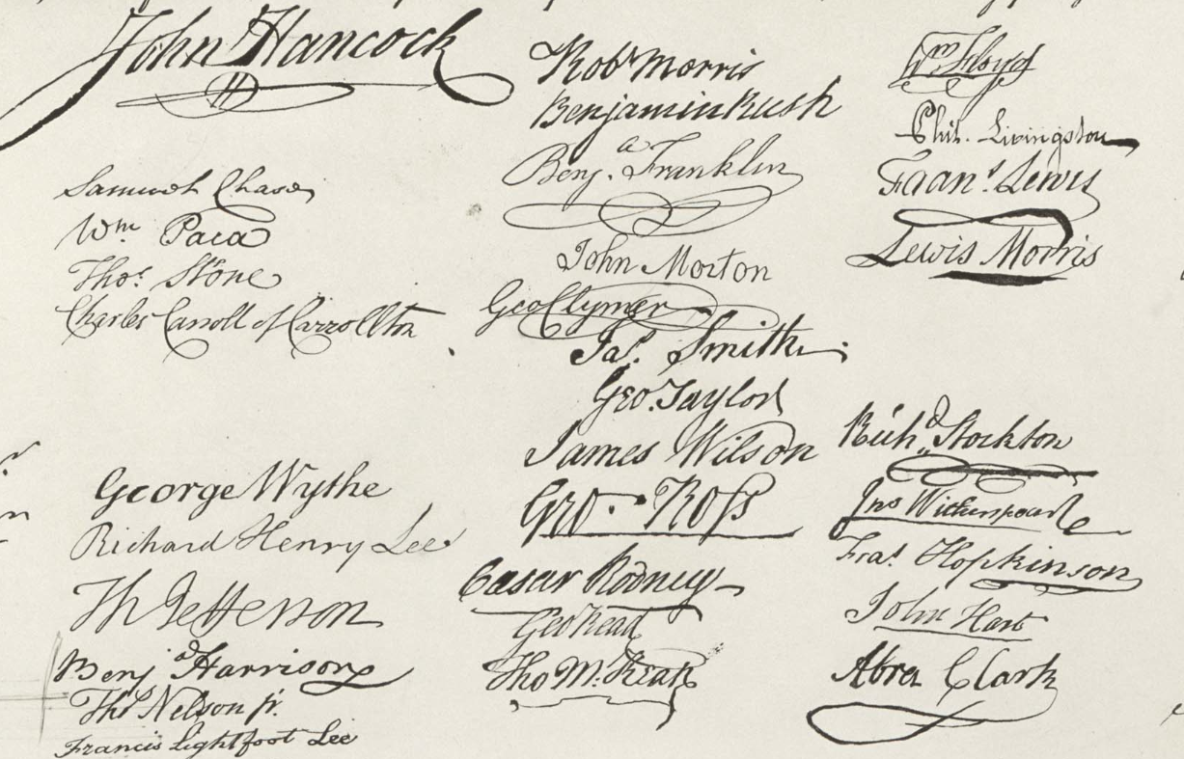
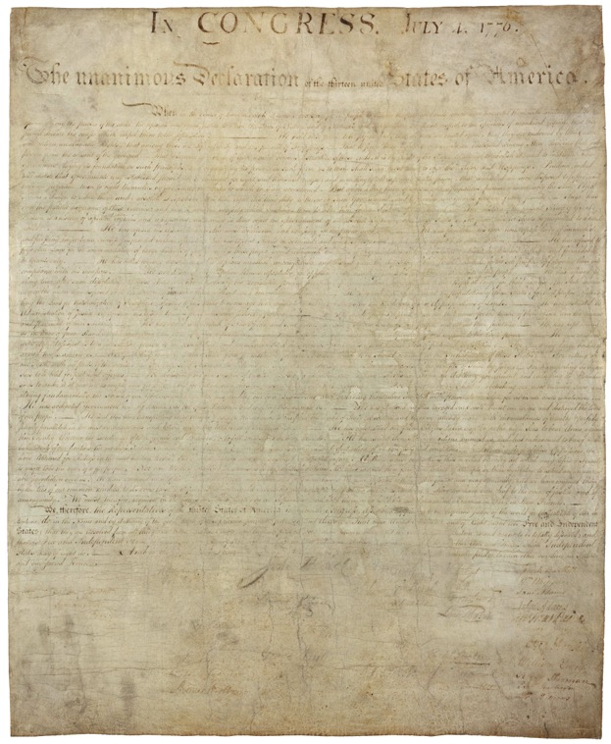
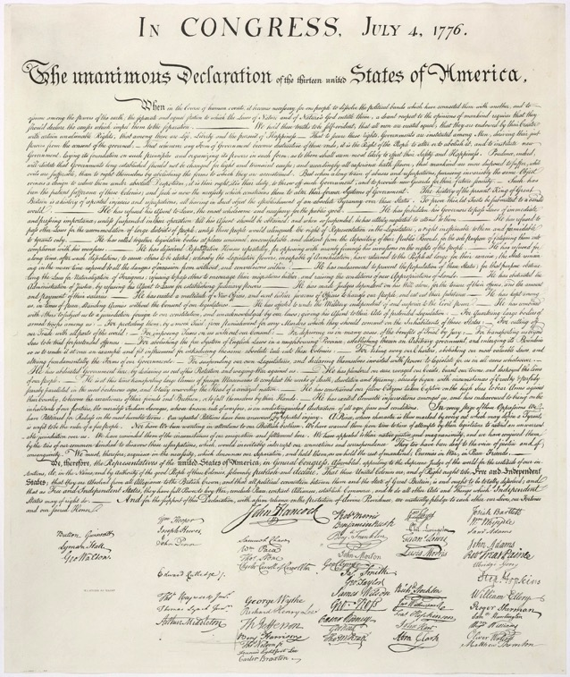
Why No Original NT Documents?
Original Declaration of Independence
AD 1776
Engraving of the Declaration by printer William J. Stone
AD 1823
Notes:
The original Declaration of 1776 is only just over 200 years old but is barely readable.
Fortunately, a printer in 1823 engraved it, which has become the most frequently reproduced version of the document.
On it you can clearly see the signatures.
However, no such preservation techniques were possible for the original OT and NT documents, so only copies preserved in arid weather survived.
It is believed by some that, after the OT and NT autographs were copied accurately and proofread, these originals were then destroyed to prevent anyone from tampering with them.
http://www.archives.gov/exhibits/charters/declaration.html

Slide 27
NT Canonicity
156-157
Apostolic
Accepted

Slide 28


Paul Called Luke's Gospel "Scripture" within 5 years!
For the Scripture says, "Do not muzzle the ox while it is treading out the grain," and "The worker deserves his wages" (1 Timothy 5:18).
Macedonia
Paul Wrote 1 Timothy
AD 62
Caesarea
Luke Written
AD 57-59
Stay in that house, eating and drinking whatever
they give you, for
the worker deserves his wages… (Luke 10:7)

Slide 29
Peter Also Called Paul's Letters "Scripture"!
Paul's Letters Written
AD 49-62
Rome
Peter Wrote 2 Peter
AD 64
"…Our dear brother Paul also wrote to you with the wisdom God gave him. He writes the same way in all his letters, speaking in them of these matters. His letters contain some things that are hard to understand, which ignorant and unstable people distort, as they do the other Scriptures, to their own destruction" (2 Peter 3:15-16)

Slide 30
NT Canonicity
156-157
Apostolic
Accepted
Doctrine

Slide 31
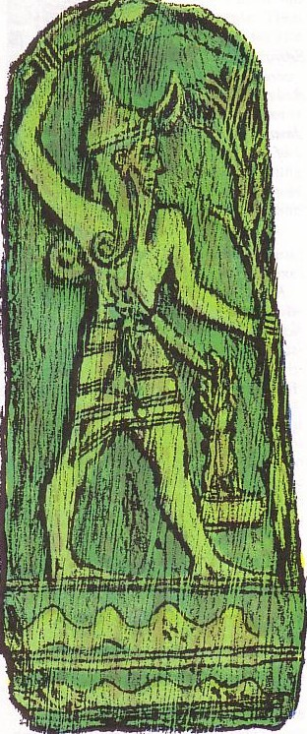
Uninspired Writings
(Backgrounds)
159-198
Greek
Roman
Jewish
Christian
Gnostic

Slide 32
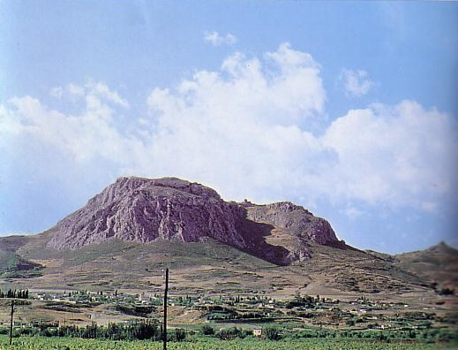
Greek Historians
159
(year of death)
Herodotus (420 BC)
Polybius (120 BC)
Diodorus (21 BC)
Strabo (AD 21)
Plutarch (AD 120)
Acrocorinth

Slide 33
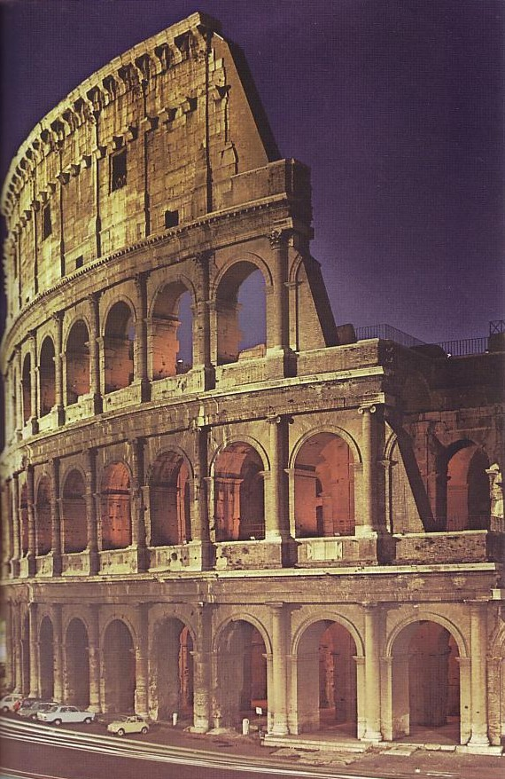
Roman Historians
159
(year of death)
Cicero (43 BC)
Livy (AD 17)
Pliny the Younger (AD 113)

Slide 34
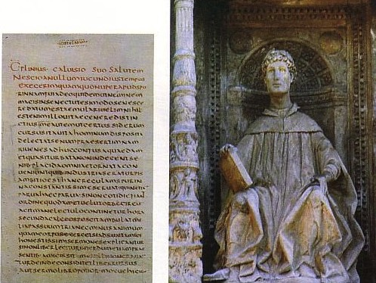
Pliny the Younger (AD 111-113)
159
Wrote letters to the Emperor Trajan
Said Christians gathered on a certain day (Sunday?) "to sing responsively a hymn to Christ as if to a god" (Epistle 10.96)—the earliest Latin reference to Jesus Christ

Slide 35

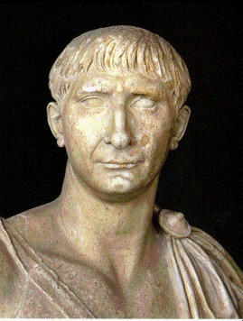

Helpful Correspondence (AD 111)
159
Emperor Trajan in Rome
Governor Pliny in Bithynia

Slide 36

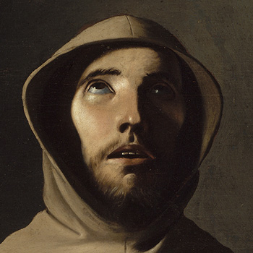
Early Church Suffering
160a
Governor Pliny to
Emperor Trajan (AD 111):
I have observed the following procedure: I interrogated these as to whether they were Christians; those who confessed I interrogated a second and a third time, threatening them with punishment; those who persisted I ordered executed…
Pliny, Letters 10.96
(c)Paul Halsall Mar 1996. halsall@murray.fordham.edu http://www.fordham.edu/halsall/source/pliny1.html
Notes:
(c)Paul Halsall Mar 1996. halsall@murray.fordham.edu http://www.fordham.edu/halsall/source/pliny1.html

Slide 37
Early Church Suffering
160a
Governor Pliny to
Emperor Trajan (AD 111):
Those who denied that they were or had been Christians, when they invoked the gods in words dictated by me, offered prayer with incense and wine to your image, which I had ordered to be brought for this purpose together with statues of the gods, and moreover cursed Christ—none of which those who are really Christians, it is said, can be forced to do—these I thought should be discharged.
Pliny, Letters 10.96
Notes:
(c)Paul Halsall Mar 1996. halsall@murray.fordham.edu http://www.fordham.edu/halsall/source/pliny1.html

Slide 38
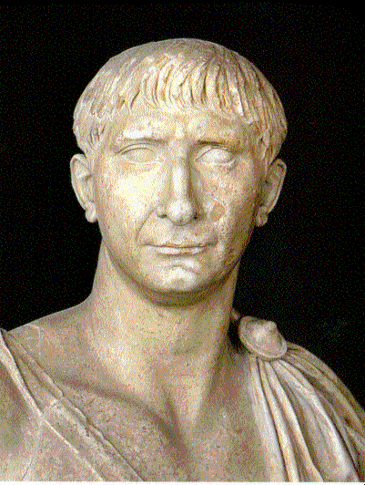
Early Church Suffering
160a
Emperor Trajan to
Governor Pliny (AD 111):
You observed proper procedure, my dear Pliny, in sifting the cases of those who had been denounced to you as Christians... They are not to be sought out... Whoever denies that he is a Christian and really proves it—that is, by worshipping our gods—even though he was under suspicion in the past, shall obtain pardon through repentance..."
Pliny, Letters 10.96
Notes:
(c)Paul Halsall Mar 1996. halsall@murray.fordham.edu http://www.fordham.edu/halsall/source/pliny1.html

Slide 39
Roman Historians
159
(year of death)
Cicero (43 BC)
Livy (AD 17)
Pliny the Younger (AD 113)
Tacitus (AD 120)
About persecuted Christians under Nero:
"Their name comes from Christus, who, in the reign of Tiberius as emperor was condemned to death by the procurator Pontius Pilate"
(Tacitus, Annals 15.44 in AD 115)

Slide 40
Roman Historians
159
(year of death)
Cicero (43 BC)
Livy (AD 17)
Pliny the Younger
(AD 113)
Tacitus (AD 120)
Suetonius (AD 121)
Claudius expulsed Jews from Rome "who had been continually stirring up trouble under the influence of Chrestus"
(oops!)
(Suetonius, Lives of the Caesars, ch. 25,
in AD 120; cf. Acts 18:2)

Slide 41

Extant Copies of Pagan vs. NT Writings
160
# | Author | When Written | Earliest Copy | Time Span | Number of Copies
6 | Plato | 347 BC | AD 900 | 1200 yrs | 7
12 | Catullus | 54 BC | AD 1550 | 1600 yrs | 3
14 | Pliny | AD 113 | AD 850 | 750 yrs | 7
NT | Paul, Luke, etc. | AD 95 | AD 200 | 100 yrs | 24,772
Move this shape over to translate text underneath!
Josh McDowell, Evidence That Demands a Verdict, 40;
John Grassmick, “NT Introduction,” Dallas Seminary class notes, 160

Slide 42
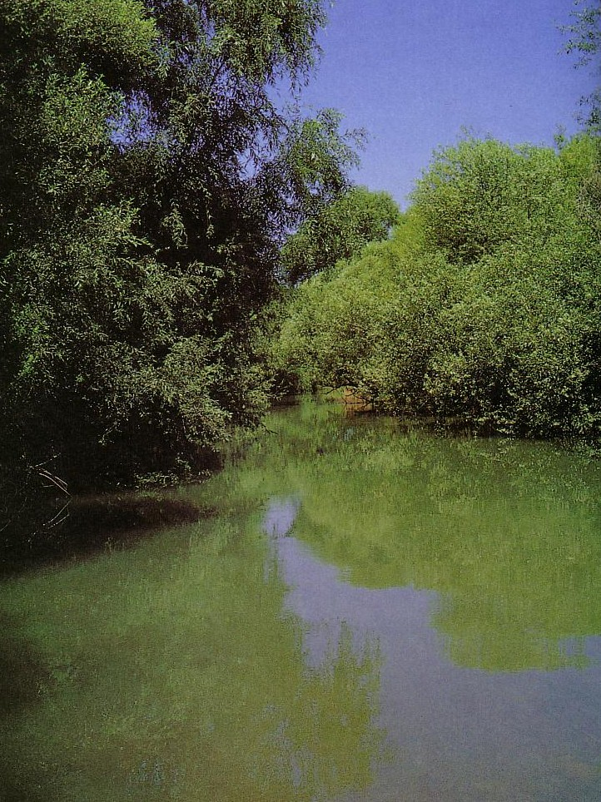
Uninspired Jewish Writings
Uninspired Jewish Writings
161-184b
Apocrypha & Pseudepigrapha
Philo
Rabbinic
Josephus
Dead Sea Scrolls

Slide 43

Apocrypha & Pseudepigrapha
Uninspired Jewish Writings
161
Apocrypha
Apocalypse
Pseudepigrapha
Deuterocanonical
Hidden
Falsely ascribed
Revealed
Second canon
Can you match the terms above with their correct meaning?

Slide 44
Apocrypha & Pseudepigrapha
Uninspired Jewish Writings
161
Apocrypha
Apocalypse
Pseudepigrapha
Deuterocanonical
= Hidden
= Revealed
= Falsely ascribed
= Second canon

Slide 45

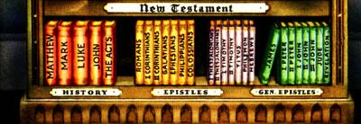
Biblical Bookshelf

Slide 46
Where they fit
Apocrypha - Pseudepigrapha - DSS

Slide 47


Sirach 2:10 (NRSV)
“Consider the
generations of old
and see: has anyone
trusted in the Lord
and been disappointed?
Or has anyone persevered
in the fear of the Lord
and been forsaken?
Or has anyone called upon him
and been neglected?”

Slide 48
Greek Philosopher Timeline
95
Persian 539-331
Greek 331-143
Hasmonean
143-63
Roman 63-
Ptolemy 301-198
Seleucid 198-143
450
400
350
300
2 5 0
2 0 0
150
100
AD
Socrates 470-399
Plato 427-347
Lucretius 98-55
Aristotle 384-322
Epicurius 340-271

Slide 49
Placement of the Septuagint
95
Persian 539-331
Greek 331-143
Hasmonean
143-63
Roman 63-
Ptolemy 301-198
Seleucid 198-143
450
400
350
300
2 5 0
2 0 0
150
100
AD
Septuagint 255

Slide 50

70 Scholars (LXX)

Slide 51

How Accepted are the 15 OT Apocryphal Books (250 BC-AD 100)?
165
Many
Most
Baruch
Letter of Jeremiah
Additions to Esther
Song of the Three Children
Susanna
Bel and the Dragon
1 Maccabees
2 Maccabees
Tobit
Judith
Wisdom of Solomon
Ecclesiasticus
A few...
1 Esdras
2 Esdras
Prayer of Manasseh
Psalm 151
3 Maccabees
4 Maccabees
Pseudepigraphal

Slide 52
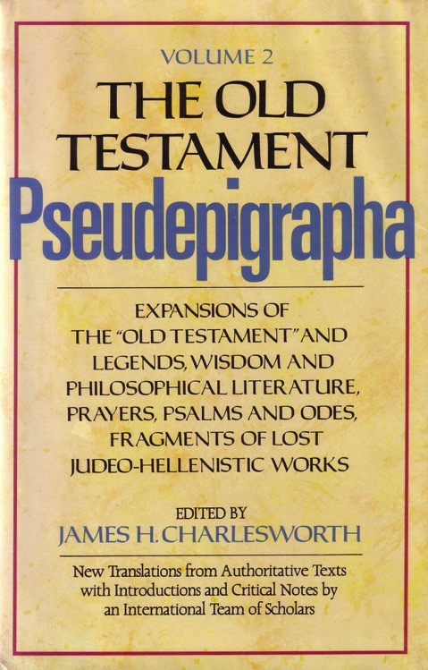
Selected Pseudepigrapha (200 BC-AD 200)
166
1 Enoch
Psalms of Solomon
Letter of Aristeas
Sibylline Oracles
Life of Adam & Eve
Testament of the 12 Patriarchs
Book of Jubilees
Lives of the Prophets
3 Maccabees
4 Maccabees
Assumption of Moses
2 Baruch
Ascension of Isaiah

Slide 53
Literary Categories
161-162
APOCALYPTIC
1 Enoch
2 Esdras
WISDOM
Ecclesiasticus
Wisdom of Solomon
FICTION
Tobit
Judith
Letter of Aristeas
Susanna
Bel and the Dragon
3 Maccabees
Sibylline Oracles
HISTORY
1 Esdras
1 Maccabees
2 Maccabees

Slide 54

No Gaps in Genesis 5
Jude quotes 1 Enoch
Adam
State lengths of time
Shorter lengths
Most natural
Show father-son
Jude 14
Seth
Enosh
7
Kenan
Mahalalel
Jared
Enoch
"Enoch, in the seventh generation from Adam, prophesied saying. . ."
(Jude 14a, NASB)
Methuselah
Lamech
Noah

Slide 55
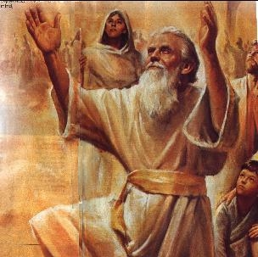
Enoch as a Prophet
Jude quotes 1 Enoch
"Enoch, who lived in the seventh generation after Adam, prophesied about these people"
(Jude 14a NLT).

Slide 56
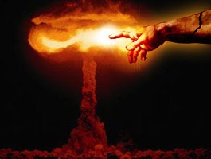
Quoting The Book of Enoch
Jude quotes 1 Enoch
[Enoch] said, “Listen! The Lord is coming with countless thousands of his holy ones ¹⁵to execute judgment on the people of the world. He will convict every person of all the ungodly things they have done and for all the insults that ungodly sinners have spoken against him” (Jude 14b-15 NLT).

Slide 57
Terminology of Authoritative Writings
164
 | Jews | Protestants & Anglicans | Catholics | Eastern Orthodox
39 OT Books | Bible (inspired) | Old Testament (inspired) | Old Testament (inspired) | Old Testament (inspired)
27 NT Books | New Testament (uninspired) | New Testament (inspired) | New Testament (inspired) | New Testament (inspired)
4 Apocryphal Books (Tobit, Judith, etc.) | Apocrypha (uninspired; not in MT but in LXX) | Apocrypha (uninspired) | Deuterocanonical (canonical since 1546) | Apocrypha (canonical since 1673)
8 Apocryphal Books (1-2 Macc) | Apocrypha (uninspired) | Apocrypha (uninspired) | Deuterocanonical (since 1546) | Apocrypha (authoritative)
3 Apocryphal Books (Esdras, Manasseh) | Apocrypha (uninspired) | Apocrypha (uninspired) | Non-canonical (but in appendix) | Apocrypha (authoritative)
3 Pseudepigraphal Books: 3-4 Macc, Psalm 151 only | Pseudepigrapha | Pseudepigrapha (uninspired) | Apocrypha (but in appendix) | Apocrypha (authoritative)
60+ Pseud Books (esp. 1 Enoch) | Pseudepigrapha (uninspired) | Pseudepigrapha (uninspired) | Apocrypha (uninspired) | Pseudepigrapha (uninspired)

Slide 58


Why are these books doubted?
163
Why are these books doubted?
Never recognized as authoritative
False theology
PURGATORY:
The result of sacrifices for pagan dead–"and thus he made atonement for the dead that they might be freed from their sin"
(2 Maccabees 12:46)
SALVATION BY WORKS:
"It is better to give to the poor than to store up gold. Such generosity will save you from death and will wash away all your sins."
(Tobit 12:8b-9a GNB)

Slide 59
Why are these books doubted?
163
Why are these books doubted?
Never recognized as authoritative
False theology
No claim of inspiration
Lack of dynamic character
Suspicious history of RCC acceptance

Slide 60
So do these books have any value?
163
So do these books have any value?
Yes!
Intertestament history
Jewish sects and institutions
Theological beliefs (e.g., angels)

Slide 61
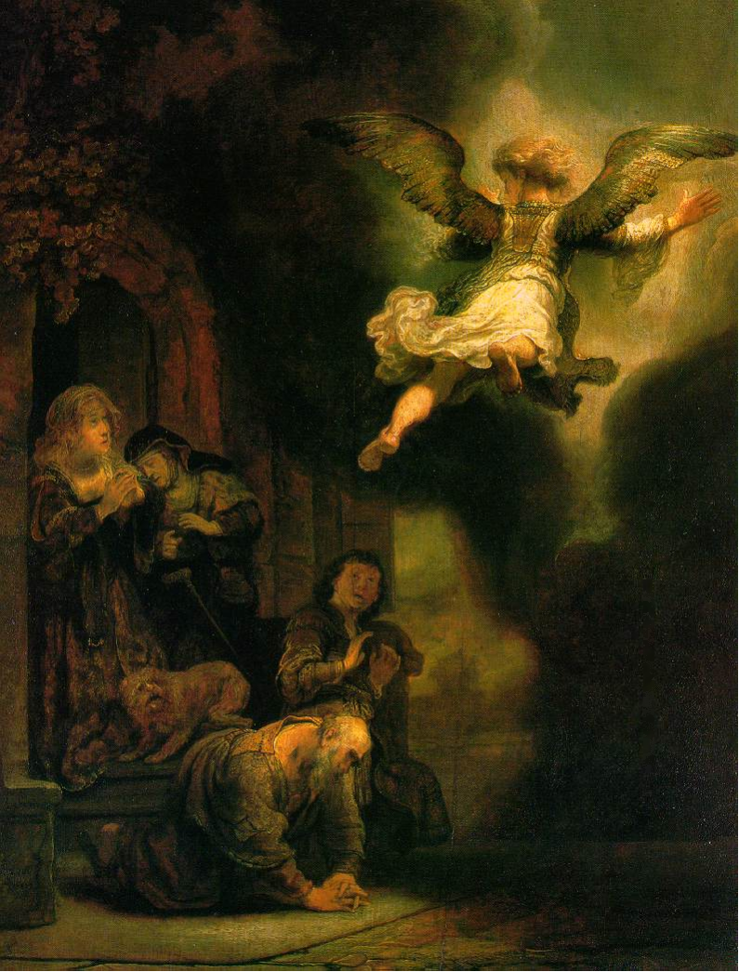
Archangel leaving the Family of Tobias
(This picture is on the front of your class notes)
Rembrandt, 1637
Notes:
http://www.google.com.sg/imgres?imgurl=keptar.demasz.hu/arthp/art/r/rembran/painting/biblic1/tobias.jpg&imgrefurl=http://keptar.demasz.hu/arthp/html/r/rembran/painting/biblic1/&h=1045&w=795&sz=134&tbnid=s5jpeQ2vX3oJ:&tbnh=149&tbnw=113&start=6&prev=/images%3Fq%3DBiblical%2Bfamily%26imgsz%3Dxxlarge%26svnum%3D10%26hl%3Den%26lr%3D%26ie%3DUTF-8%26safe%3Dactive%26sa%3DG

Slide 62
So do these books have any value?
163
So do these books have any value?
Yes!
Intertestament history
Jewish sects and institutions
Theological beliefs (e.g., angels)
Lexical backgrounds (e.g., "age to come")
Literary forms (e.g., letters)
Balance to rabbinic writings

Slide 63
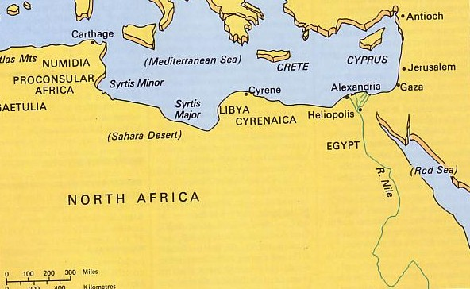
2. Philo of Alexandria
Uninspired Jewish Writings
168
Allegorical Method
Influenced Christian hermeneutics (e.g., “1000 yrs.”)

Slide 64
Chronological Literature Chart
158
Dates show time of writing and works appear in italics
400 300 200 100 BC/AD 100 200 300 400 500 600 700
GREEK LXX
(Greek OT)
Polybius
Diodorus
Strabo
Plutarch
----- Hermetica ----
Philo
JEWISH ^{(Jewish/Greek)}
OT Jamnia "Council" MT
(completed) 600-1000
------OT Apocrypha-----
---------- Pseudepigrapha -------(some extended to 7th century)
- Dead Sea Scrolls -
---------------- Rabbinic Literature --------------
------------- Midrash (oral tradition) ----------
Talmud = Mishnah 200 + Gemara 500
--- Tosefta ---
Josephus 77-94
ROMAN (Jew writing for Rome)
Cicero
Livy
Pliny 113
Tacitus 115
CHRISTIAN
New Testament 40s-95
Apostolic Fathers 95-150
Most notable:
• Didache 95-120
• Epistle of Barnabas 70-132
----------------- NT Apocrypha ----------------
• Nag Hammadi Codices (Gnostic)
• Gospel of Thomas
MISCELLANEOUS
------------------------------- Select Papyri --------------------------------------------

Slide 65
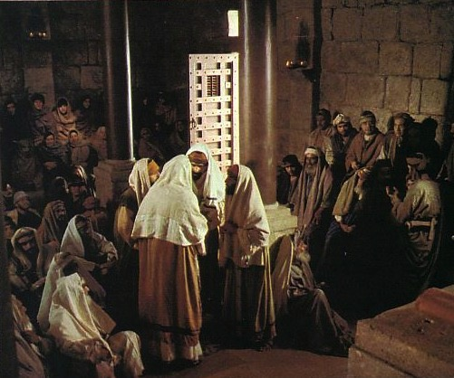

Rabbinic Literature
(100 BC-AD 500)
Uninspired Jewish Writings
168-170
Midrash
  Halakah
  Haggadah
Talmud
  Mishna
  Gemara
Tosefta

Slide 66
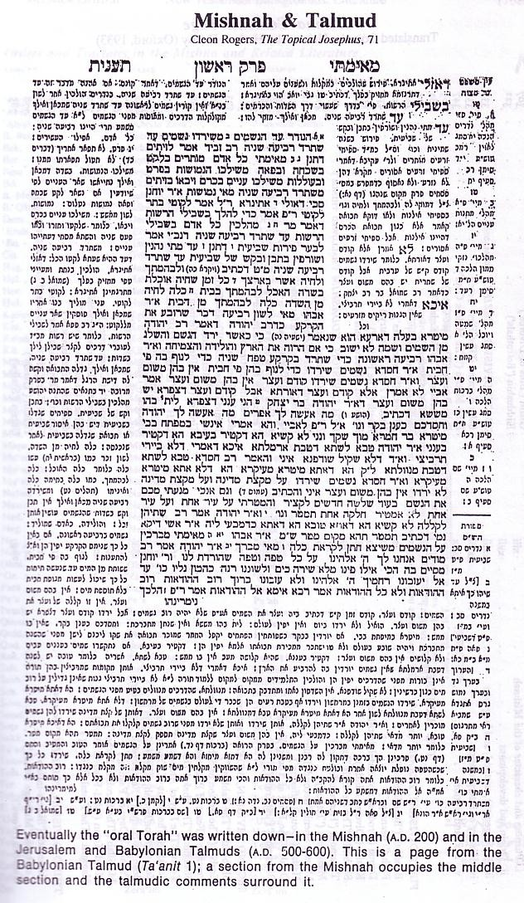

The Babylonian Talmud
169b
The Babylonian Talmud
Mishnah
— oral law of the rabbis
  — AD 200
+
Gemara
  — comments on Mishnah
  — AD 500-600
Mishnah
Gemara

Slide 67
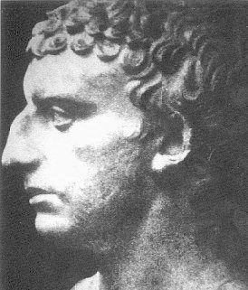
4. Josephus
Uninspired Jewish Writings
171
Life in 3 Stages:
Pharisee
General
Historian
AD 37 – ca. 100

Slide 68
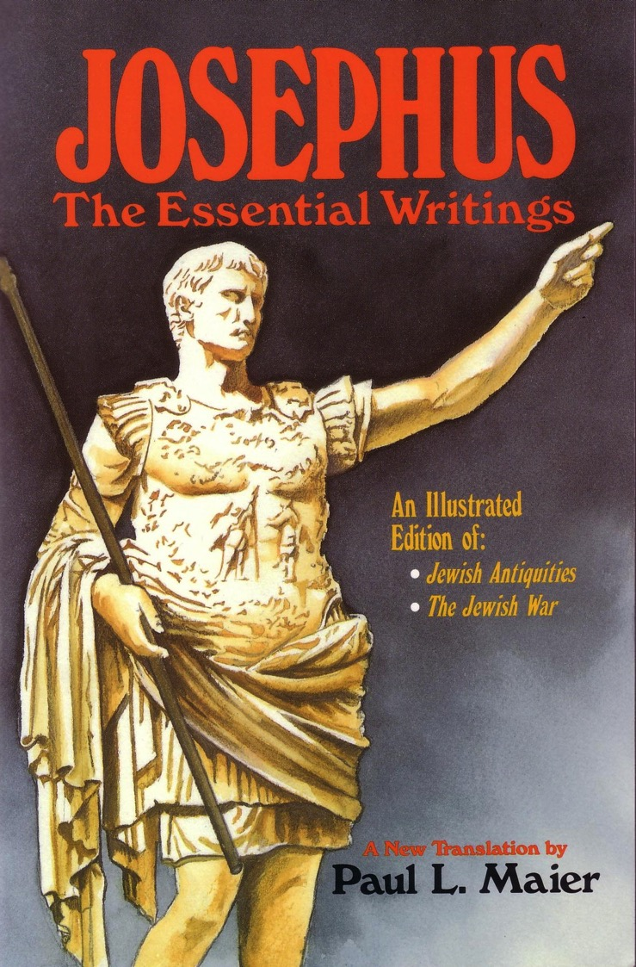
4. Josephus
Uninspired Jewish Writings
171
Writings:
Jewish War (AD 77)
Antiquities (AD 93-94)
Life
Against Apion

Slide 69
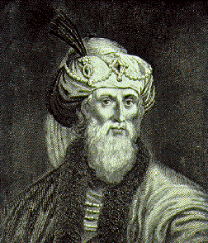
Evaluation of Josephus
Uninspired Jewish Writings
171
Roman bias
Exaggerations
Egotism
Digressions

Slide 70
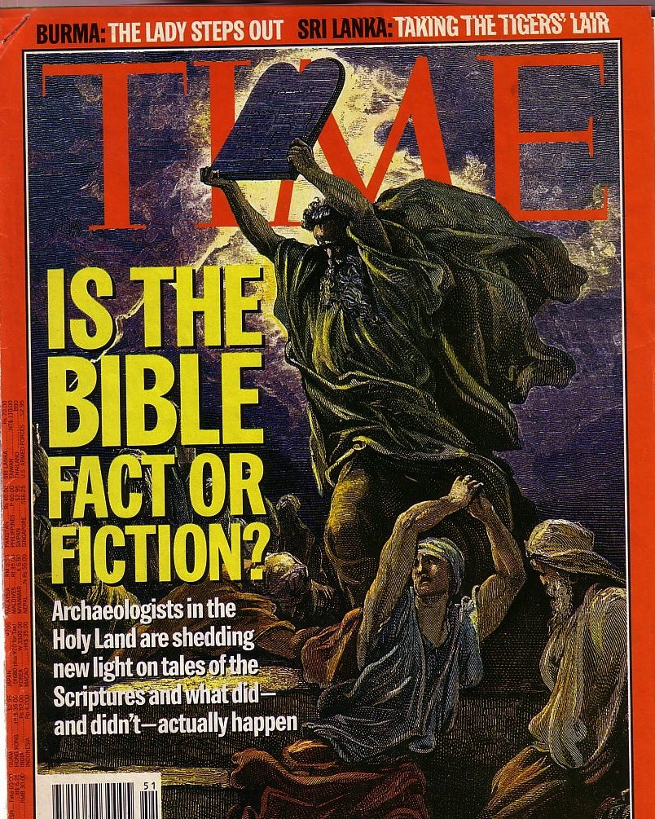
Attacks Continue
The Bible is continually attacked
However, discoveries continue to verify its accuracy

Slide 71
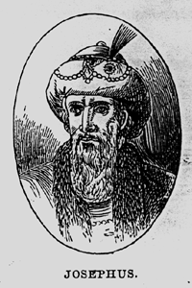
Significance of Josephus
Uninspired Jewish Writings
172
Earliest non-Christian witness to the historicity of Jesus Christ
(AD 93-94)

Slide 72
Short quote by Josephus
Uninspired Jewish Writings
172
"Convening the judges of the Sanhedrin, he [Ananus, son of Annas] brought before them a man named James, the brother of Jesus who was called the Christ, and certain others. He accused them of having transgressed the law, and condemned them to be stoned to death"
(Ant. 20.9.1 in Maier, 276; cf. Whiston, 4:140).
Josephus inaccurately refers to James as the brother of Jesus (cf. Acts 12:1-2; AD 44).

Slide 73

Long quote (two versions)
Uninspired Jewish Writings
172
Jewish | Christian
"At this time there was a wise man called Jesus, and his conduct was good, and he was known to be virtuous. Many people among the Jews and the other nations became his disciples. Pilate condemned him to be crucified and to die. But those who had become his disciples did not abandon his discipleship. They reported that he appeared to them three days after his crucifixion and that he was alive. Accordingly, he was perhaps the Messiah, concerning whom the prophets have reported wonders. And the tribe of the Christians, so named after him, has not disappeared to this day." | "About this time lived Jesus, a wise man, if indeed one ought to call him a man. For he was the achiever of extraordinary deeds and was a teacher of those who accept the truth gladly. He won over many Jews and many of the Greeks. He was the Messiah. When he was indicted by the principal men among us and Pilate condemned him to be crucified, those who had come to love him originally did not cease to do so; for he appeared to them on the third day restored to life, as the prophets of the Deity had foretold these and countless other marvelous things about him. And the tribe of Christians, so named after him, has not disappeared to this day."

Slide 74
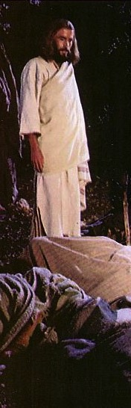

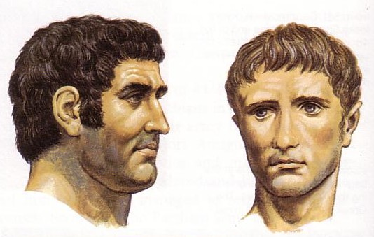

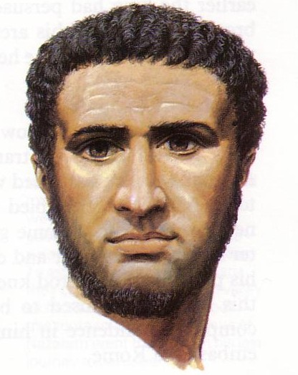
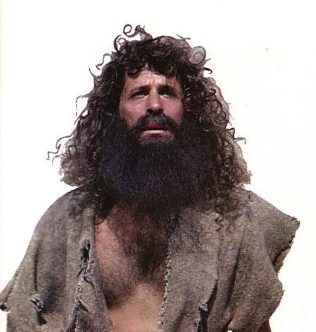
Significance of Josephus
Uninspired Jewish Writings
172
Translate text UNDERNEATH the pictures! View this in slide show mode.
Earliest non-Christian witness to the historicity of Jesus Christ
Most important source for NT Backgrounds
Notes:
Translate text UNDERNEATH the pictures! View this in slide show mode.
Josephus give us more information than does the NT on Annas & Caiaphas, Antony & Augustus, Herod the Great, Pontius Pilate, and John the Baptist. Only on Jesus does the NT have more information than Josephus!

Slide 75


Jerusalem Siege Wall (AD 70)
Leen & Kathleen Ritmeyer, "Akeldama: Potter's Field or High Priest's Tomb?" BAR 20 (Nov/Dec 94): 34

Slide 76
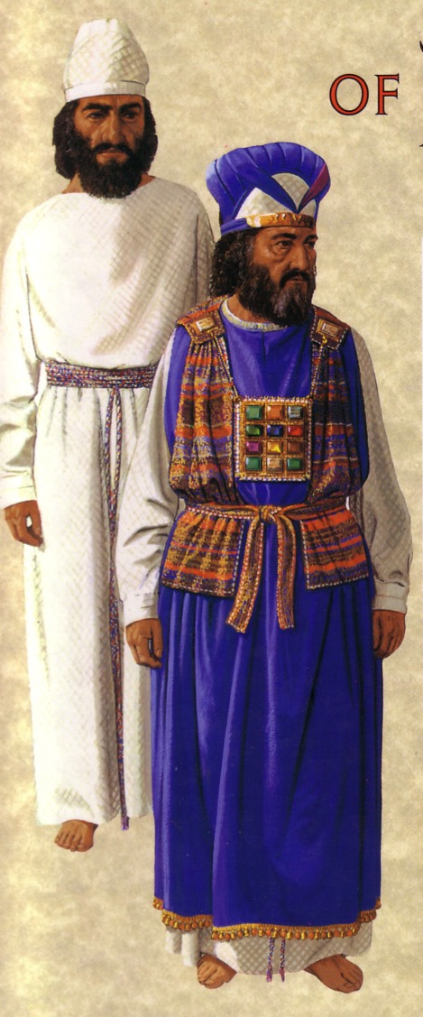

Significance of Josephus
Uninspired Jewish Writings
172
Earliest non-Christian witness to the historicity of Jesus Christ
Most important source for NT Backgrounds
Highlights the best of Jewish life

Slide 77

5. Dead Sea Scrolls
Uninspired Jewish Writings
174
The DSS are the most extensive literary discovery illuminating the Bible
Therefore we will devote the entire next session to discuss them

Slide 78

Christian Literature
The Epistle of Barnabas
The Apostolic Fathers
The Didache
186

Slide 79

The Didache ("Teaching")
186
The earliest guide to church teaching
Baptism by immersion "in running water" (7.1)
First mention of alternate baptism by pouring "water on the head three times" (7.3)
If a missionary "stays three days, he is a false prophet" (11.5)
Worship on Sunday, or "on the Lord's own day" (14.1)
"Appoint for yourselves bishops and deacons" (15.1)

Slide 80

Gnostic Literature
186
Rejected
The NT Apocrypha (AD 100-600)
The Gospel of Thomas

Slide 81
NT Apocrypha: 18 Gospels
186
GOSPELS
Arabic Gospel of the Infancy
Armenian Gospel of the Infancy
Assumption of the Virgin
Resurrection of Christ by Bartholomew
History of Joseph the Carpenter
Protoevangelium (Infancy Gospel) of James
Notes:
Brown supposes that "all gospels are created equal," including these 16 heretical gospels that came a century after Christ.

Slide 82
NT Apocrypha: 18 Gospels
186
The Gospel of:
• Bartholomew • the Birth of Mary
• Basilides • Pseudo-Matthew
• Cerinthus • the Hebrews
• the Ebionites • Philip
• Mary Magdalene • Thomas
• Marcion • Infancy Gospel of Thomas
Notes:
These Gnostic works do not amount to "80 gospels" as Brown claims. What they say is so esoteric that few read them.

Slide 83
NT Apocrypha: 21 "Acts"
186
Apostolic History of Abdias
Fragmentary Story of Andrew
Ascent of James
Martyrdom of Matthew
Passion of Paul
Passion of Peter and Paul

Slide 84
NT Apocrypha: 21 "Acts"
186
The Acts of:
• Andrew
• Andrew and Matthias • Peter
• Andrew and Paul • Peter and Andrew
• Barnabas • Peter and Paul
• James the Great • Philip
• John • Pilate
• John by Prochorus • Thaddeus
• Paul • Thomas

Slide 85


NT Apocrypha: Others
186
APOCALYPSES
James Stephen
Paul Thomas
Peter The Virgin
EPISTLES
Epistles of Christ and Abgarus
Epistle of the Apostles
Third Epistle to the Corinthians
Epistle to the Laodiceans
Epistle of Lentulus
Epistles of Paul and Seneca
Apocryphal Epistle of Titus

Slide 86

Early Gnosticism
153d

Slide 87

Early Gnosticism in 1 John
153d
Two Types
Docetic Gnosticism
Matter is Evil
Depreciated Materialism
Denied Christ's Humanity
Touched Jesus (1:1)
Asceticism
Immorality
Cerinthian Gnosticism
Spirit is Good
Exalted Knowledge (gnosis)
Denied Christ's Deity
Water & Blood (5:6)
Pride
Education

Slide 88

The Gospel of Judas
186a
Judas said, "Master, could it be that my seed is under the control of the rulers?" Jesus answered and said to him, "… you will grieve much when you see the kingdom and all its generation." When he heard this, Judas said to him, "What good is it that I have received it? For you have set me apart for that generation." Jesus answered and said, "You will become the thirteenth, and you will be cursed by the other generations—and you will come to rule over them. In the last days they will curse your ascent [47] to the holy [generation]."

Slide 89
The Gospel of Judas
186a
Judas said to Jesus, "Look, what will those who have been baptized in your name do?" Jesus said, "… Truly [I] say to you, Judas, [those who] offer sacrifices to Saklas [...]God [—three lines missing—] everything that is evil. But you will exceed all of them. For you will sacrifice the man that clothes me."

Slide 90

Irenaeus (AD 180)
186b
1. Others again declare that Cain derived his being from the Power above, and acknowledge that Esau, Korah, the Sodomites, and all such persons, are related to themselves. On this account, they add, they have been assailed by the Creator, yet no one of them has suffered injury. For Sophia was in the habit of carrying off that which belonged to her from them to herself. They declare that Judas the traitor was thoroughly acquainted with these things, and that he alone, knowing the truth as no others did, accomplished the mystery of the betrayal; by him all things, both earthly and heavenly, were thus thrown into confusion. They produce a fictitious history of this kind, which they style the Gospel of Judas.
Against Heresies 1.31.1
Notes:
http://www.ccel.org/fathers2/ANF-01/anf01-60.htm#P7477_2003920

Slide 91


How should we fight heresy?

Slide 92

Laughing all the way to the bank…
$260 million after 12 million copies sold
$100 million from other books
Now 40 million books sold

Slide 93

Who is this?
John?
or Mary?
Brown says John is actually Mary Magdalene, the wife of Jesus Christ!
However, da Vinci is only depicting John in the typical Florentine fashion as "the beautiful young man"

Slide 94

Mary Magdalene as the "Companion" (Wife) of Christ?!
And the companion of the [...] Mary Magdalene. [...] loved her more than all the disciples, and used to kiss her often on her mouth. The rest of the disciples [...]. They said to him "Why do you love her more than all of us?"
The Gospel of Philip
(Gnostic NT Apocrypha)
But…
If Jesus really was married then why would the disciples be jealous?
"Companion" need not indicate a wife. Jesus had several traveling companions, many of them women.
The word rendered "mouth" is obscured in the original and so it is supplied by translators. It could just as easily been her head, hand, or cheek.
This is a second-century heretical work.
http://www.gnosis.org/naghamm/gop.html
Notes:
http://www.gnosis.org/naghamm/gop.html
Image is of the Gospel of Thomas on the same site.

Slide 95


Brown's Thesis
"Constantine and his male successors successfully converted the world from matriarchal paganism to patriarchal Christianity by waging a campaign of propaganda that demonized the sacred feminine, obliterating the goddess from modern religion forever"
(The Da Vinci Code, 104).
Notes:
In other words, the original feminine Christianity became masculine Christianity by imperial decree. We have already noted that paganism was not strictly feminine since all high gods were male. I should also point out that goddess worship seems hardly eliminated forever.

Slide 96

Brown encourages goddess worship!
Notes:
Sadly, the ultimate experience espoused in Brown's story is a sex ritual with a couple having intercourse with others chanting around them in a circle. Sophie is rightly aghast at this perversion of sex--until she is convinced that all this is the divine design! Brown seeks to bring us back to ritualistic sex outside of marriage. I wonder if his wife agrees with this?

Slide 97


Gnostics Favored Men Anyway
Simon Peter said to them, "Make Mary leave us, for females don't deserve life.” Jesus said, "Look, I will guide her to make her male, so that she too may become a living spirit resembling you males. For every female who makes herself male will enter the kingdom of Heaven."
Gospel of Thomas
Saying 114
(final verse)
Notes:
Even Brown's understanding of Gnosticism is flawed. This heresy was flatly anti-feminine. It is no wonder that he makes no mention of this last verse of the second-century Gospel of Thomas! Sometimes facts can harm one's thesis.
http://www.gnosis.org/naghamm/gosthom.html
THE GNOSTIC SOCIETY LIBRARY
The Nag Hammadi Library
The Gospel of Thomas
Translated by Stephen Patterson and Marvin Meyer(

Slide 98
Note on Greek & Hebrew Fonts
BWHEBB, BWHEBL [Hebrew]; BWGRKL, BWGRKN, and BWGRKI [Greek] Postscript® Type 1 and TrueType™ fonts Copyright © 1994-2002 BibleWorks, LLC. All rights reserved. These Biblical Greek and Hebrew fonts are used with permission and are from BibleWorks, software for Biblical exegesis and research.

Slide 99


NT Backgrounds link at BibleStudyDownloads.org
Get this presentation for free!
Notes:
NT Backgrounds (nb)

Slide 100
Black

